Slide 1
A Guide to AHEPA Online Membership
Presented by
Rosalind N. Ofuokwu, MBA-Director of Membership
Review of key membership portal functions
You will learn how to:
    Sign-on as first-time user
    Manage personal account
    Manage chapter/member account (for assigned chapter officers only)
    Chapter dues payment (for assigned chapter officers only)
    Download reports (for assigned chapter/district/national officers only)
    Join New Member online
    IMPORTANT INFORMATION: ONLY assigned Chapter Officers can pay for their members’ dues online at this time. Individual members however can view/download their membership card and manage their account profile

Slide 2
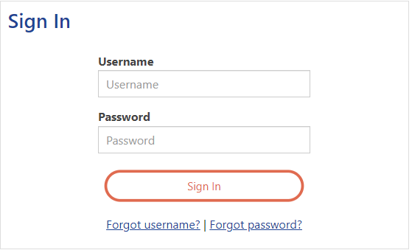
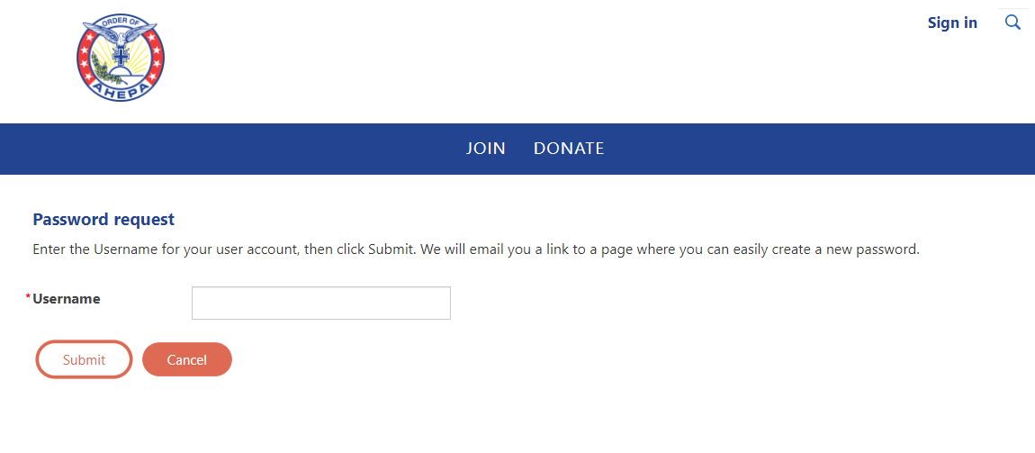
Q. HOW DO I ACTIVATE MY ACCOUNT
Go to https://members.ahepa.org
You will be routed to the Sign-in Membership Home Page – see below screen shot
Activate your account by clicking on “Forgot password” Link
A dialog box will open up – see below screen shot
At the ‘Username’ field, enter an email address and hit submit (please note, the email address entered will be cross referenced to the email address on file at headquarters to complete your request to activate your online account)

Slide 3
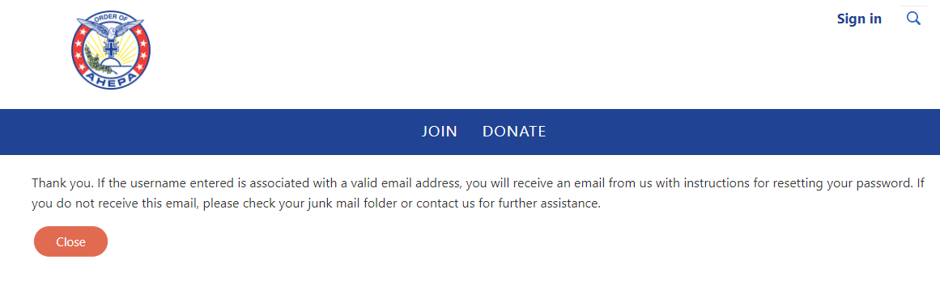
Q. HOW DO I ACTIVATE MY ACCOUNT CONT’D
Once your email address is submitted, the system validates the address
Please check your email inbox on instructions for resetting password.

Slide 4
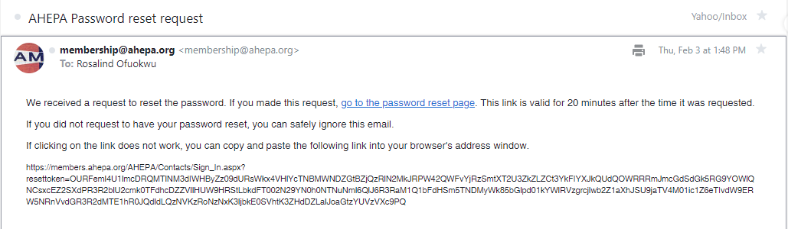
Q. HOW DO I ACTIVATE MY ACCOUNT CONT’D
Click on the link as provided to reset your password.

Slide 5
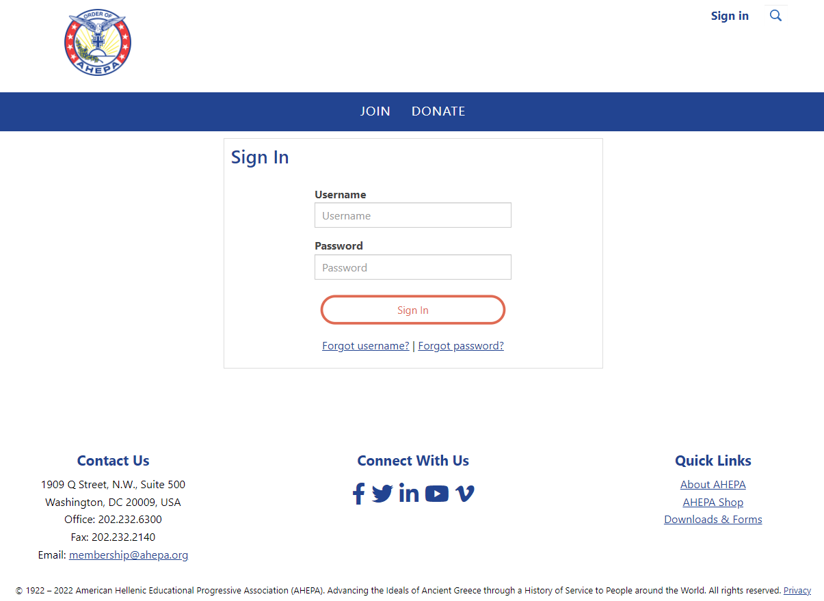
Q. UNABLE TO LOGIN (SYSTEM NOT RECOGNIZING MY EMAIL)
Please email membership@ahepa.org and provide your current email address and membership ID. Once email has been updated in the system, you will receive an email to re-activate your account by going to the Sign-in home page – see below screen shot, click the ‘Forgot password’ link (follow instructions as provided on screen)

Slide 6
FOR CHAPTER OFFICERS: GENERAL INFORMATION ON INITIATING/REINSTATING MEMBER ONLINE
For chapters whose members were initiated online, in order for “Membership Certificates” to be mailed, endorsed application forms MUST be mailed to Headquarters (1909 Q St., NW, Ste 500, Washington, DC 20009) OR emailed to membership@ahepa.org.

Slide 7
Q: CAN HEADQUARTERS COLLECT CHAPTER DUES?
According to the IRS, we are a 501(c)(10) operating under a lodge system.
If Headquarters is to collect chapter and district dues at varied amounts, we would not be operating under a lodge system and would therefore lose our exemption as a 501(c)(10) organization.
However, if Chapters were to agree on a fixed amount for membership dues, Headquarters would be able to collect the chapter amount and issue the chapter’s portion back to the chapter.

Slide 8
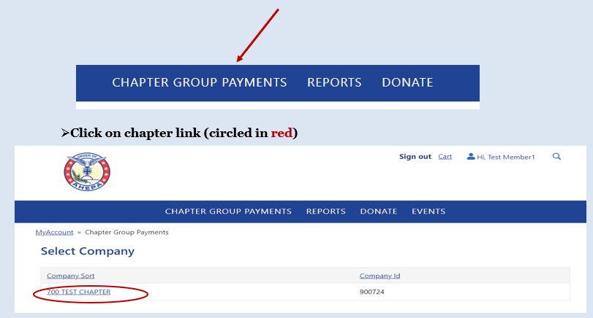
CHAPTER DUES PAYMENT PROCESS
If you are a chapter officer, use your login credentials to log in to your member page
Click on the “Chapter Group Payment” tab and click on the Chapter Name

Slide 9
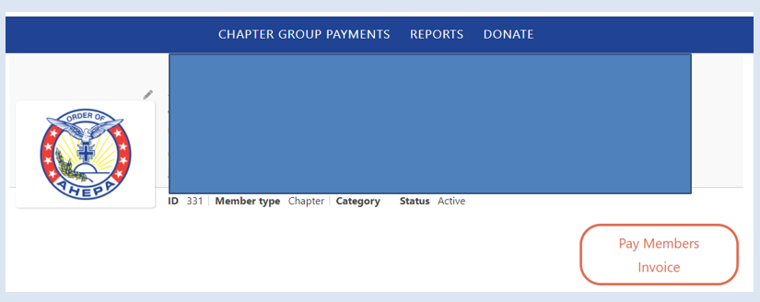
CHAPTER DUES PAYMENT PROCESS - CONT’D
Click on “Pay Members Invoice”

Slide 10
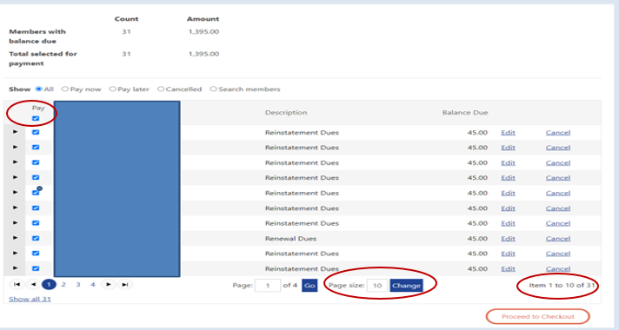
CHAPTER DUES PAYMENT PROCESS - CONT’D
To begin payment, first uncheck the “Pay” box for selection
Click on show all OR you may expand the “Page size” by highlighting the default number and enter number as shown on the “Item section”. E.g. below screenshot shows 31. Click “Proceed to Checkout” once selection is completed
Important note: Please DO NOT click on “Edit” or “Cancel” or “Cancelled” these are system administrator functions

Slide 11
CHAPTER DUES PAYMENT PROCESS - CONT’D
Payment options include credit card and e-check. A confirmation receipt will be emailed after payment is complete.
Note: The credit card address entered MUST match the credit card billing address. If the card billing address does not match, before entering card information, please click on “Choose another address” at the bottom to update and click “OK” when finished

Slide 12
PAYING BACK DUES & OFFICER ACCESS
Back dues cannot be paid online. Chapter officer paying back dues (years missed) for members should remit payment to headquarters via postal mail for processing.
The top four Chapter Officers have access to their chapter reports (Chapter President, Chapter Vice President, Chapter Secretary/Recording Secretary, and Chapter Treasurer).
The top four District Officers have access to the chapter reports within their district. (District Governor, District Lt. Governor, District Secretary, District Treasurer)

Slide 13
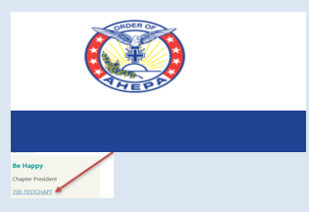
MANAGING MEMBER INFORMATION (Chapter Officers)
To manage members’ information, click on Chapter link (see below screenshot) on the left corner of your page; scroll down to “Chapter Roster” section, click on the member name you wish to update contact information; click on the edit button (looks like a pen), once update is completed click on ‘Save’ – Note: You cannot edit Title, Date of Birth, Gender, Years of Service, Membership ID and Join Date - these are system administrative functions

Slide 14
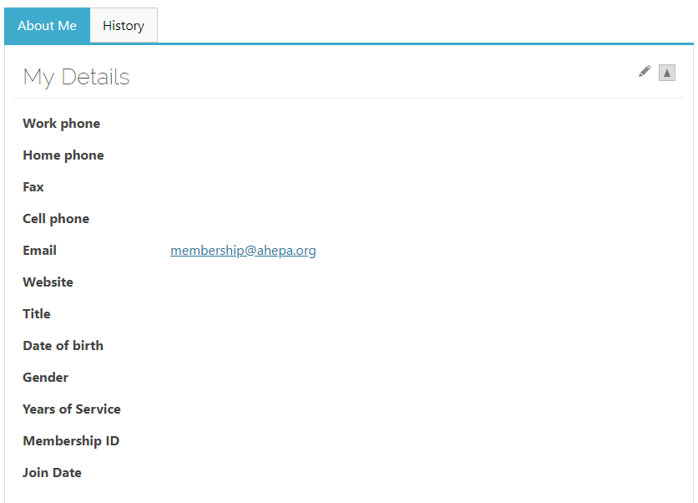
MEMBER PROFILE – ABOUT ME TAB
Under the About Me tab, click on the pen in the right hand corner (see arrow) to edit your information.
Note: You cannot edit: Title, Date of birth, Years of Service, Membership ID or Join Date

Slide 15
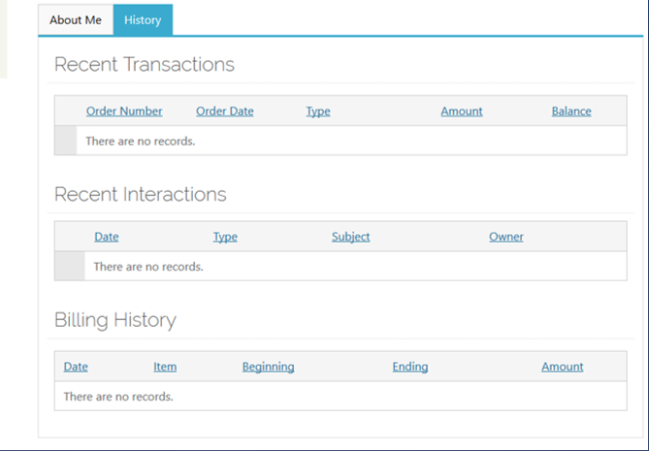
MEMBER PROFILE – HISTORY TAB
Under the History Tab, you can view recent transactions, interactions and billing history.
For example, once you pay your membership dues online or any other transaction, you will be able to view the transaction on this tab

Slide 16
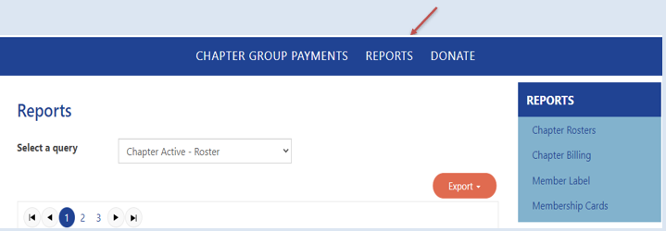
DOWNLOADING REPORTS AND MORE
To view/download reports, click the Reports tab on the top right corner and then click on the link labeled Chapter Rosters which takes you to the report page to download chapter rosters; member labels & chapter billing and more (Chapter Billing download for Chapter Officers only)

Slide 17
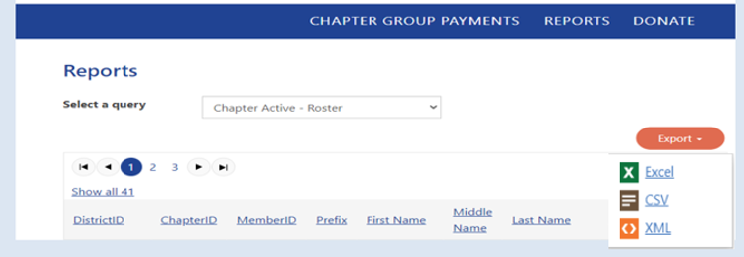
EXPORTING THE REPORT TO DOWNLOAD
On the report page, the below screen will appear. Choose the reports you wish to view by selecting the report via the drop down menu where it says Select a query. Select the desired report by clicking on the drop down report menu. Once the report is selected, click on Export to download (please note, pop-up must be enabled for reports to download)
Note: for District or National officers, to select by Chapter number, enter (3) characters- e.g. for chapter 1 enter 001. By District number enter (2) characters – e.g. for district 1 enter 01. For International chapters, to select by chapter (5) characters, e.g. Greece to select chapter 001, first enter for ‘HJ’ followed by the (3) chapter character (HJ001) for Canada ‘CJ’ followed by the (3) chapter number and so forth

Slide 18
DOWNLOADING DELINQUET ROSTERS
Please note when downloading Delinquent Roster, select by member’s ‘Paid Through Date’ (delinquency range starts from “Paid Through Between” 12/31/2010 and 12/31/2020)

Slide 19

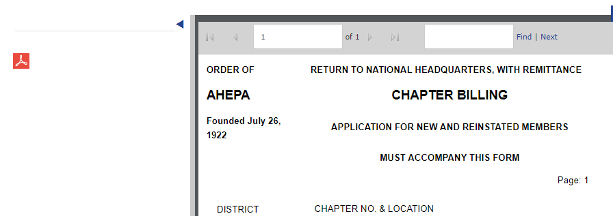
EXPORTING/PRINT THE CHAPTER BILLING
To view/download chapter billing, click the Reports tab in the top right corner and then click on the link labeled Chapter Billing which takes you to the report page to download the report
Click the PDF icon to the left to download for printing

Slide 20
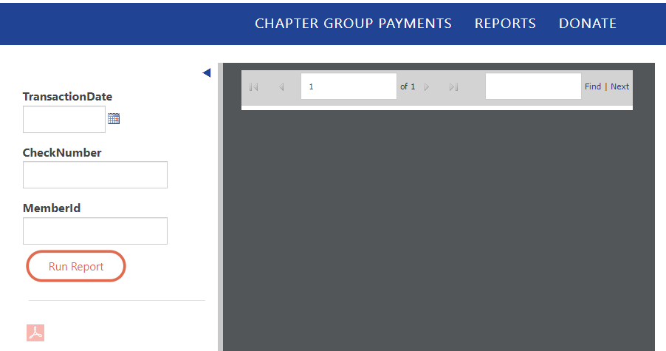

DOWNLOADING MEMBERSHIP CARDS
To print membership cards, click on the Reports tab on the right corner of your profile page and click on the link labeled Membership Cards
You may download cards by: (please note: selection is one field per search)
MemberID
Check Number
Transaction Date (This option is ONLY for online credit card & E Check payment – please enter the date payment was made online)
Click Run Report (you will see the print preview)
Click on PDF to complete download (please make sure pop-up is enable)
Please note: paper style (perforated template Avery 5390 or similar dimension) – please make sure to adjust your printer if necessary by going to your printer option “more settings” and on Scale, select “Fit to printable area”

Slide 21
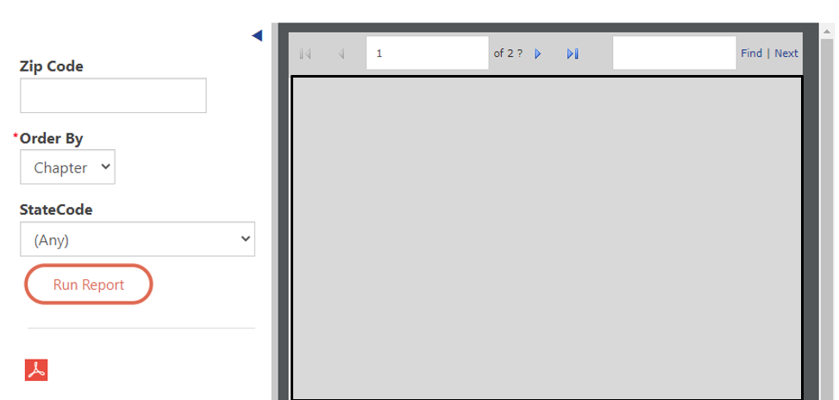
DOWNLOADING MEMBERSHIP LABELS
To print labels, click on the Reports tab and click on the link labeled Chapter Member Label; click on Run Report to download Note: for District or National officers, to select by Chapter number, enter (3) characters. By District number enter (2) characters. For International chapters, to select by chapter (5) characters, e.g. Greece to select chapter 001, first enter ‘HJ’ followed by the (3) chapter character (HJ001) for Canada ‘CJ’ followed by the chapter number and so forth

Slide 22
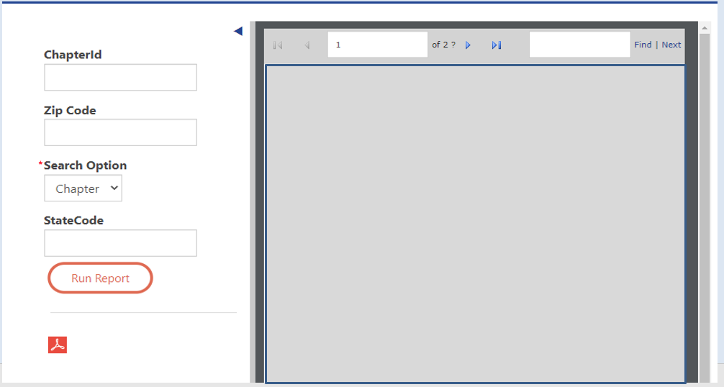
REPORTS DOWNLOAD – MEMBER LABELS
Member Labels
Click Run Report; click on PDF icon for download
Insert Avery 5160 or 5960 return labels in your printer tray and print

Slide 23
JOINING NEW MEMBER ONLINE
Go to https://ahepa.org
Click on “Membership” tab
Click on “Start Here” under “Chapter”
Complete information as shown on screen. (PLEASE DO NOT Sign in to your personal account to join a new member)
On Organization field, enter chapter number. For local chapter number, enter (3) characters- e.g. for chapter 1 enter 001. By District number enter (2) characters – e.g. for district 1 enter 01. For International chapters, to select by chapter (5) characters, e.g. Greece to select chapter 001, first enter ‘HJ’ followed by the (3) chapter character (HJ001) for Canada ‘CJ’ followed by the (3) chapter number and so forth

Slide 24
GENERAL INFORMATION
Please feel free to contact headquarters at membership@ahepa.org should you have any questions
AHEPA Membership website: https://members.ahepa.org

